Slide 1

Introduction to Operating Systems CS/COE 1550
Spring 2020-2021
Sherif Khattab
ksm73@pitt.edu
(Some slides are from Silberschatz, Galvin and Gagne ©2013)

Slide 2
Announcements
Upcoming deadlines:
4/22: Homework 12
4/23: Lab 5
4/26: Project 4
5/2: Quiz 4
5/2: Bonus homework
Extra lecture
Tophat questions due one week after each lecture
OMETs
1 bonus point when response rate >= 80%
Deadline Sunday 4/25

Slide 3
Last Lecture …
Low-level device driver issues
Disk structure and scheduling
File and Directory operations

Slide 4
Muddiest Points
Checked on Tophat

Slide 5
Today’s Agenda …
OS Protection
Access Control Matrix

Slide 6
Protection
Protection is about controlling access of programs, processes, or users to the system resources (e.g., memory pages, files, devices, CPUs)
How to decide who can access what?
Specifications must be
Correct
Efficient
Easy to use (or nobody will use them!)

Slide 7
Protection domains
A process operates within a protection domain
resources accessible by the process
each domain lists objects with permitted operations
Domains can share objects & permissions
Objects can have different permissions in different domains
There need be no overlap between object permissions in different domains
How can this arrangement be specified more formally?
File1 [R] File2 [RW]
File3 [R]
File4 [RWX]
File5 [RW]
File3 [W]
Screen1 [W]
Mouse [R]
Printer [W]
Domain 1
Domain 2
Domain 3

Slide 8
Protection matrix
 | File1 | File2 | File3 | File4 | File5 | Printer1 | Camera
Domain1 | Read | Read Write
Domain2 |  |  | Read | Read Write Execute | Read Write | Write
Domain3 |  |  | Write |  |  | Write | Read
Each domain has a row in the matrix
Each object (resource) has a column in the matrix
Entry for <object, column> has the permissions
Who’s allowed to modify the protection matrix?
What changes can they make?
How is this implemented efficiently?

Slide 9
Domains as objects in the protection matrix
Domain | File1 | File2 | File3 | File4 | File5 | Printer1 | Camera | Dom1 | Dom2 | Dom3
1 | Read | Read Write |  |  |  |  |  | Modify
2 |  |  | Read | Read Write Execute | Read Write | Write |  | Modify
3 |  |  | Write |  |  | Write | Read |  | Enter
Specify permitted operations on domains in the matrix
Domains may (or may not) be able to modify themselves
Domains can modify other domains
Some domain transfers (switching) permitted, others not
Doing this allows flexibility in specifying domain permissions
Retains ability to restrict modification of domain policies

Slide 10
Representing the protection matrix
Need to find an efficient representation of the protection matrix (also called the access matrix)
Most entries in the matrix are empty!
Compress the matrix by:
Associating permissions with each object: access control list
Associating permissions with each domain: capabilities
How is this done, and what are the tradeoffs?

Slide 11
Access control lists (ACLs)
Each object has a list attached to it
List has
Protection domain (User name, Group of users, Other)
Access rights (Read, Write, Execute, Others)
No entry for domain => no rights for that domain
Operating system checks permissions when access is needed
File1
File2
elm: <R,W> znm: <R> root: <R,W,X>
elm: <R,X> uber: <R,W> root: <R,W> all: <R>

Slide 12
Access control lists in the real world
Unix file system
Access list for each file has exactly three domains on it
User (owner)
Group
Others
Rights include read, write, execute: interpreted differently for directories and files
AFS
Access lists only apply to directories: files inherit rights from the directory they’re in
Access list may have many entries on it with possible rights:
read, write, lock (for files in the directory)
lookup, insert, delete (for the directories themselves),
administer (ability to add or remove rights from the ACL)

Slide 13
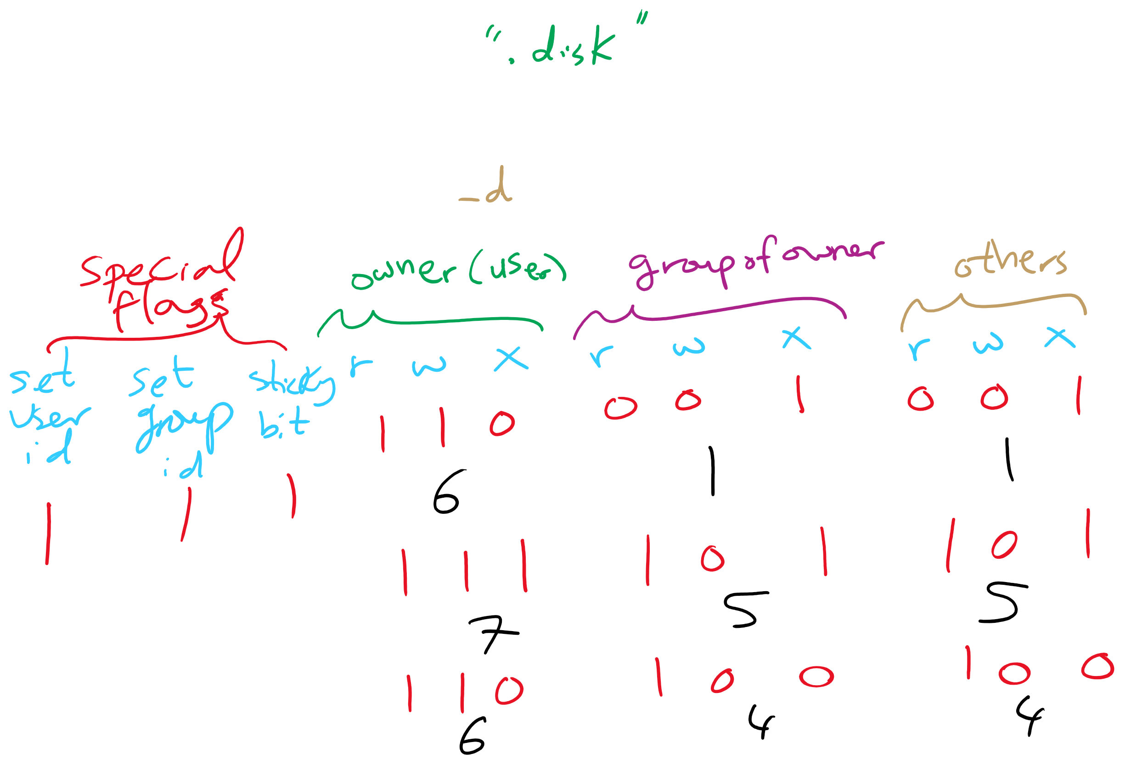
ACL in UNIX

Slide 14
Capabilities
Each process has a capability list
List has one entry per object the process can access
Object name
Object permissions
Objects not listed are not accessible
How are these secured?
Kept in kernel
Cryptographically secured
Process A
Process B
File1: <R,W> File2: <R> File3: <R,W,X>
File2: <R,W> File4: <R,W,X> File7: <W> File9: <R,W>

Slide 15
Cryptographically protected capability
Server
Object
Rights
H(Object,Rights,Check)
Rights include generic rights (read, write, execute) and
Copy capability
Copy object
Remove capability
Destroy object
Server has a secret (Check) and uses it to verify capabilities presented to it
Alternatively, use public-key signature techniques

Slide 16
Protecting the access matrix: summary
OS must ensure that the access matrix isn’t modified (or even accessed) in an unauthorized way
Access control lists
Reading or modifying the ACL is a system call
OS makes sure the desired operation is allowed
Capability lists
Can be handled the same way as ACLs: reading and modification done by OS
Can be handed to processes and verified cryptographically later on
May be better for widely distributed systems where capabilities can’t be centrally checked

Slide 17
Reference monitor
Process A
All system calls go through the reference monitor for security checking
User space
Operating system kernel
Trusted computing base
Reference monitor
Kernel space

Slide 18
Formal models of secure systems
Limited set of primitive operations on access matrix
Create/delete object
Create/delete domain
Insert/remove right
Primitives can be combined into protection commands
OS can enforce policies, but can’t decide what policies are appropriate
Question: is it possible to go from an “authorized” matrix to an “unauthorized” one?
In general, undecidable
May be provable for limited cases

Slide 19
Bell-La Padula multilevel security model
Processes, objects have security level
Simple security property
Process at level k can only read objects at levels k or lower
* property
Process at level k can only write objects at levels k or higher
These prevent information from leaking from higher levels to lower levels
Read down, write up
4
5
E
6
3
3
C
4
D
A writes 4
2
B
2
1
1
A

Slide 20
Biba multilevel integrity model
Principles to guarantee integrity of data
Simple integrity principle
A process can write only objects at its security level or lower
No way to plant fake information at a higher level
The integrity * property
A process can read only objects at its security level or higher
Read up, write down
Biba is in direct conflict with Bell-La Padula
Difficult to implement both at the same time!

Slide 21
Covert channels
Circumvent security model by using more subtle ways of passing information
Can’t directly send data against system’s wishes
Send data using “side effects”
Allocating resources
Using the CPU
Locking a file
Making small changes in legal data exchange
Very difficult to plug leaks in covert channels!

Slide 22
Covert channel using file locking
Exchange information using file locking
Assume n+1 files accessible to both A and B
A sends information by
Locking files 0..n-1 according to an n-bit quantity to be conveyed to B
Locking file n to indicate that information is available
B gets information by
Reading the lock state of files 0..n+1
Unlocking file n to show that the information was received
May not even need access to the files (on some systems) to detect lock status!

Slide 23
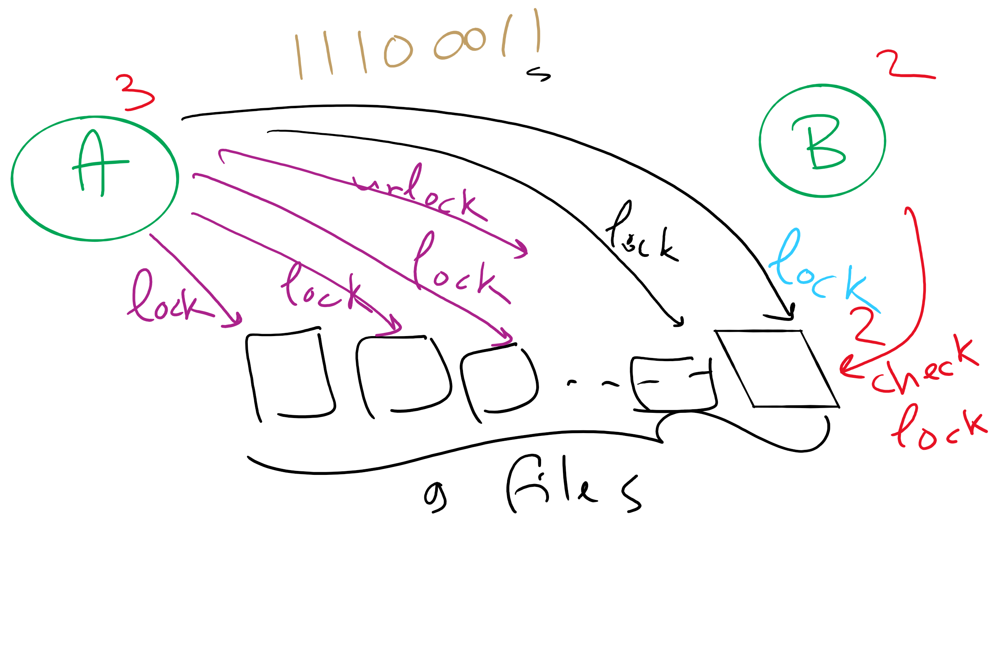
Covert Channel Using File Locking

